Slide 1
Journal GUI Project
CSI 2300
Fall 2024
Stephanie Stankovski

Slide 2
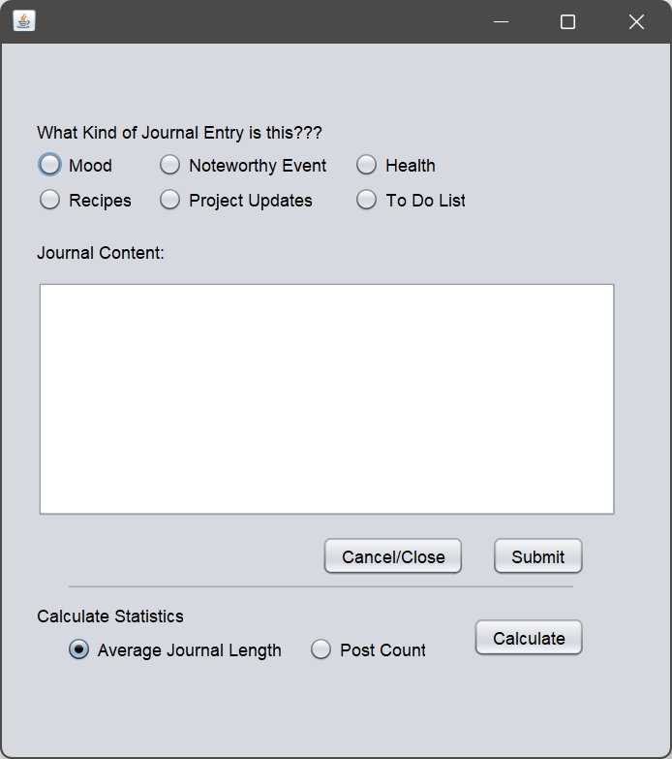
About the Project:
CSI 2300
Fall 2024
This journal application gives users space to write their thoughts or projects that they are currently working on. It also tracks how many entries they made and their average word count.
Notes:
To complete this project I used NetBeans and Swing. Additionally, this project was made entirely using Java.
This is a journal that can be used to give users a space to jot down their ideas, keep track of things that need to be done, or have a space to simply vent. It can also be used to track progress if the user wants to maintain specific goals by using the post count feature.

Slide 3
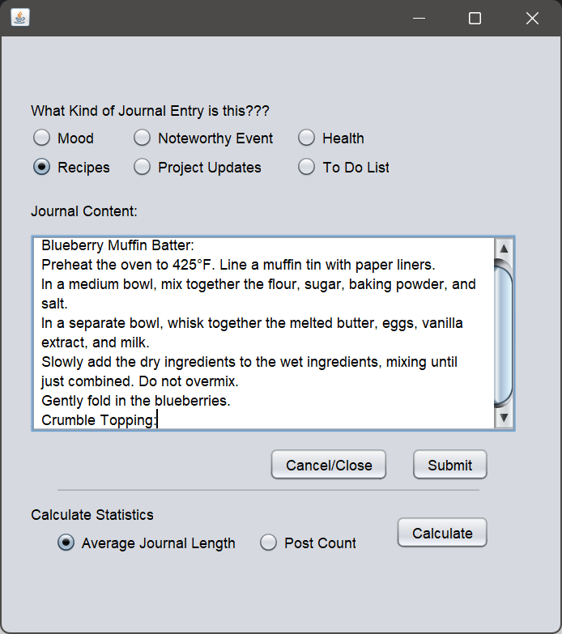
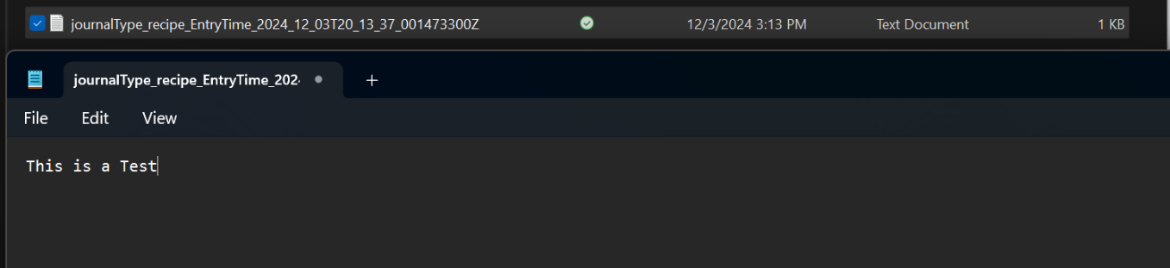
How Does it Work: Journal Entry I
CSI 2300
Fall 2024
Upon opening the application, users are prompted to enter the type of entry this will be.
Ex: recipe
The user can add their text.
Upon hitting submit, the file is then saved in the “Journal Entries” folder.
The Journal Type and date/Time it gets submitted are added to the title.
Notes:
I began this project by creating an outline of where each button/box will be placed. I wanted to create a simple journal so it doesn’t feel overwhelming and the user can just focus on the task at hand.
When the user opens the application they will select the type of journal they want to create. The user may only select one option. This choice will be added to the title of the journal.
When the user is entering the text in the box, there is no word limit.
When the user hits submit, the application will save the journal in a folder titled “Journal Entries” and will be logged for the post count and the average word length.
The date and time the journal was created will also be added to the title so the user can stay organized.
The journal will remain open until the user closes the application.

Slide 4
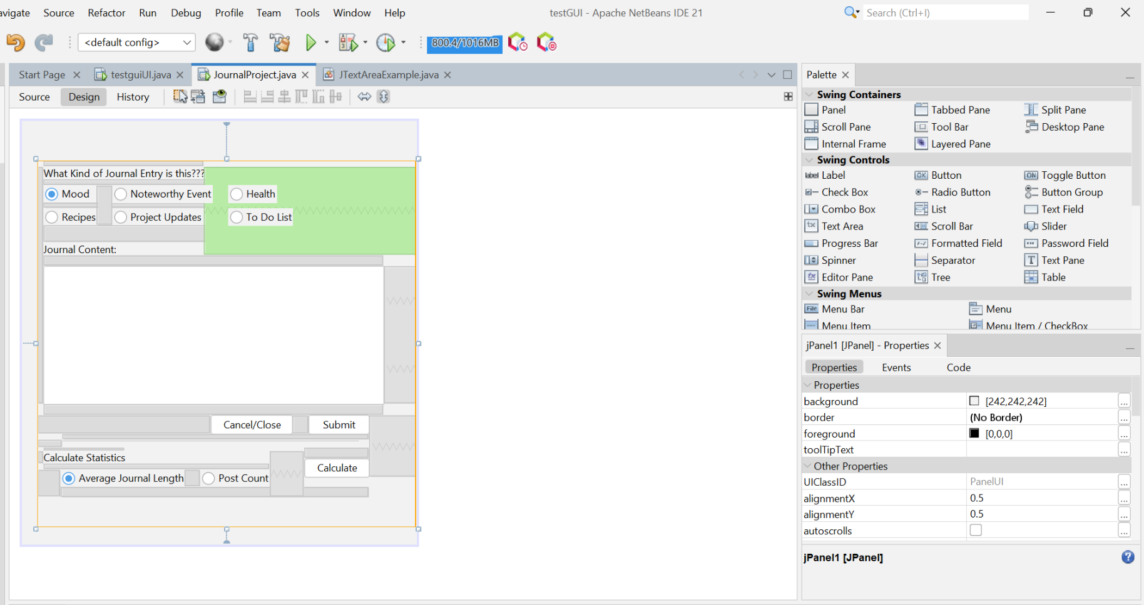
How Does it Work: Journal Entry II
CSI 2300
Fall 2024
The Journal Types are created using radio buttons.
The user may only select one at a time
The Textbox was created using the textbox and a slider so that the user can scroll left and right and up and down.

Slide 5
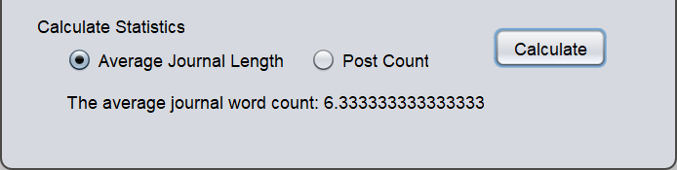
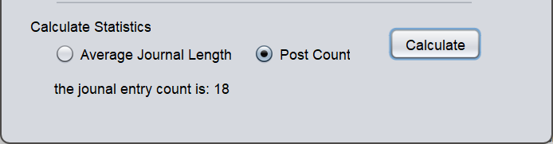
How Does it Work: Calculations
When the user submits their journal entry it will be added to the post count.
The total word count for that post will also impact the average amount of words the user wrote.
Notes:
I thought it would be interesting to add a feature that allows the user to see how many journals they created as well as their average word count. It could be used as a tool to get them to see their progress over time, if they are using it to expand in a skill or desired goal in general.
Here I utilized conditions and arrays to help with the calculations.

Slide 6
What Did I Learn
I definitely learned a lot doing this project. Putting the skills I learned to create an application was quite interesting. I tried to do things differently than I typically do with assignments or previous labs I had so I could branch out.

Slide 7


